Slide 1
HEART DISEASE TABLEAU (EDA)
File created on: 11-06-2020 08:10:18 PM

Slide 2
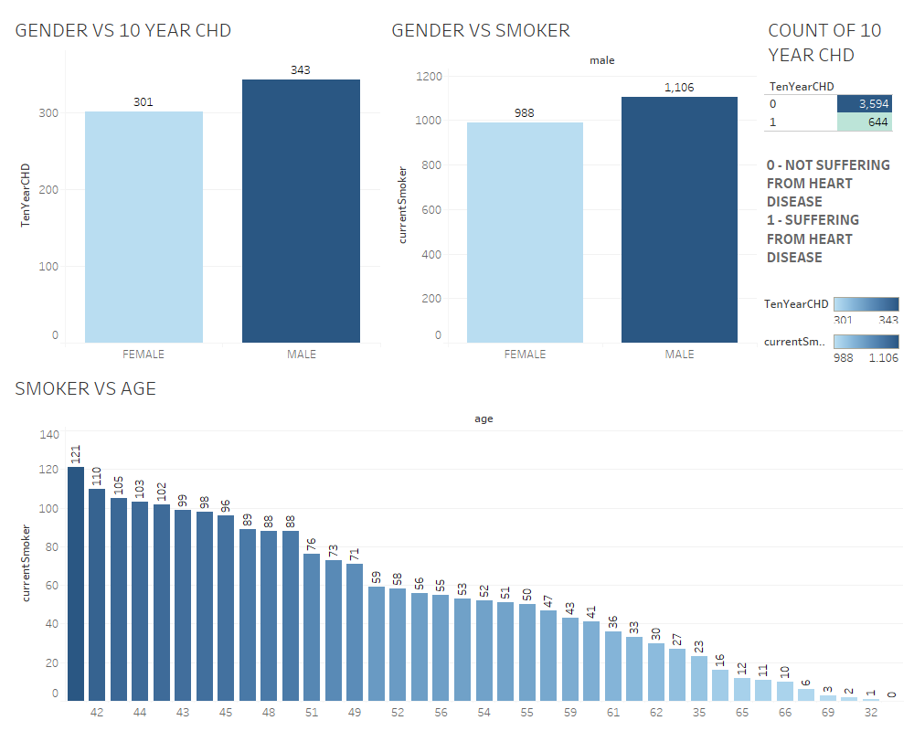

Slide 3
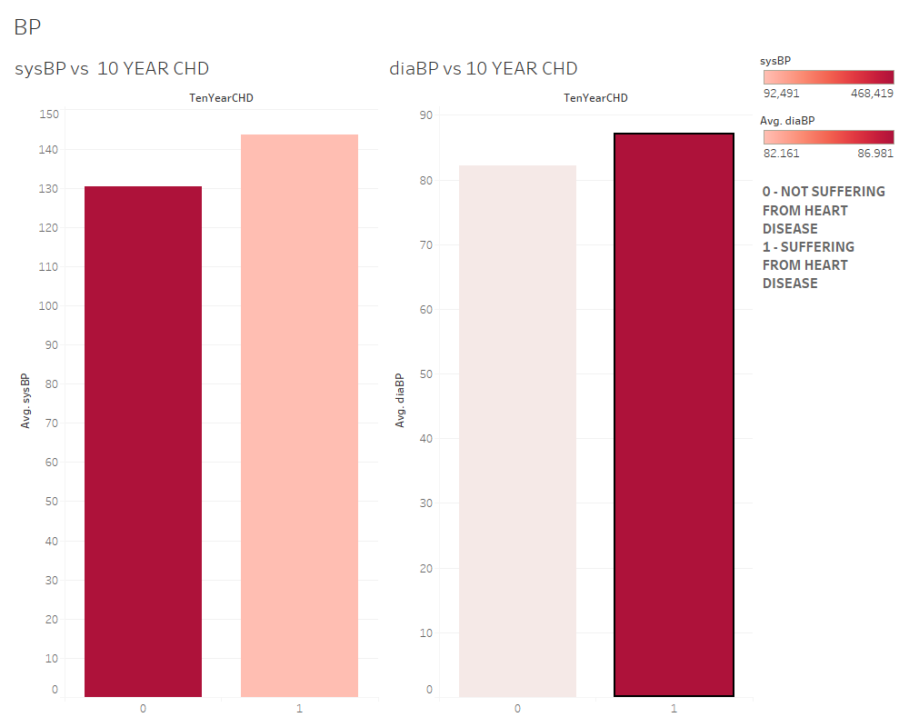

Slide 4
